Slide 1



Attention Mechanism and Transformers
Video 5: Attention Mechanism

Slide 2
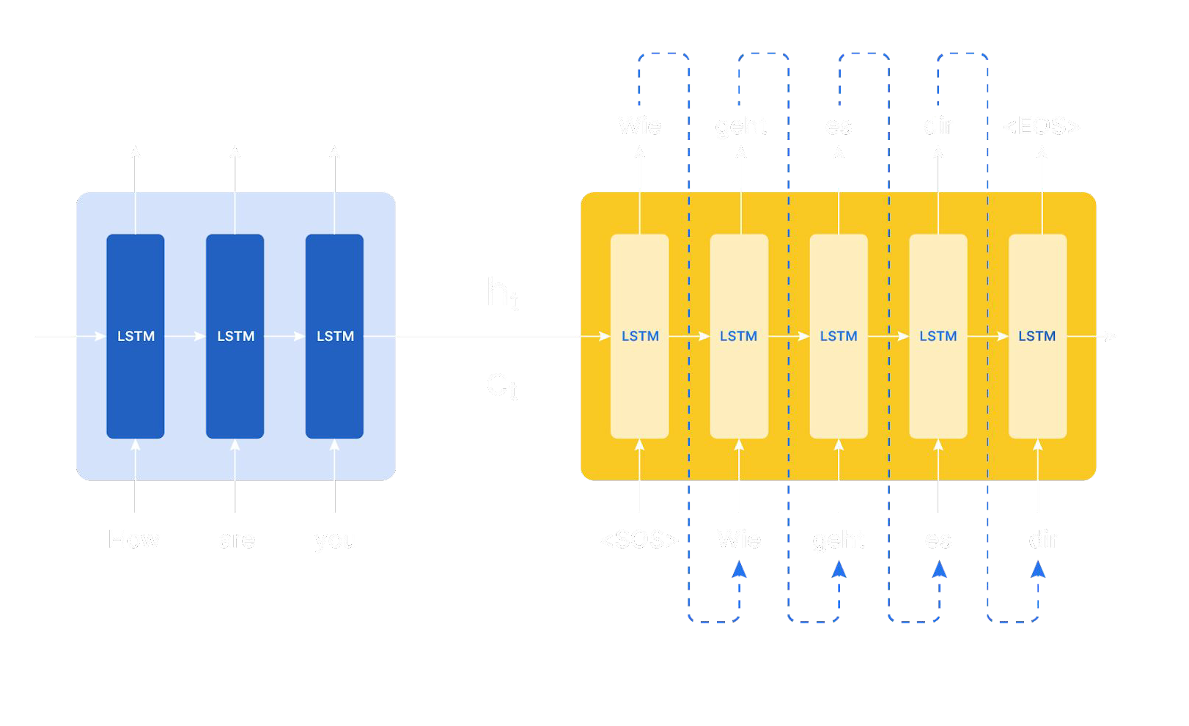
Recap
<END>
h₀
h₁
h₂
Es
<START>

Slide 3

Limitations of Encoder-Decoder
Encoder state burden: Carries all data from encoder to decoder where encoder errors may lead to translation failures.
For long texts, Encoder state may miss key info
The model struggles to prioritize important details at each time step

Slide 4
Limitations of Encoder-Decoder
y1
y2
y3
wie
geht
es
dir
<END>
How
are
you
<START>
wie
geht
es
dir

Slide 5



Attention Mechanism
y1
y2
y3
wie
geht
es
dir
<END>
How
are
you
<START>
wie
geht
es
dir

Slide 6
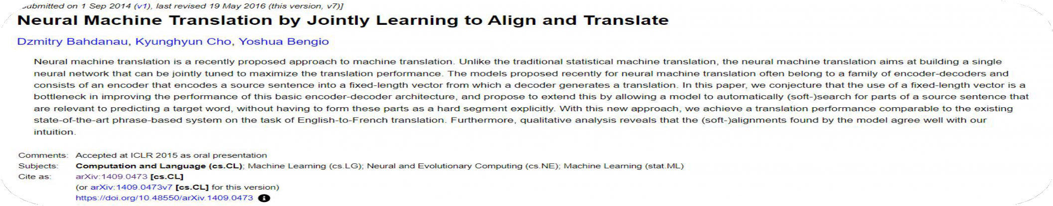
Attention

Slide 7
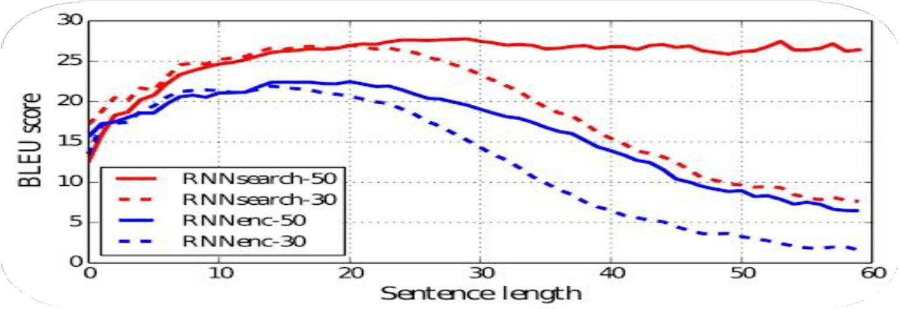
Impact of Attention Mechanism

Slide 8
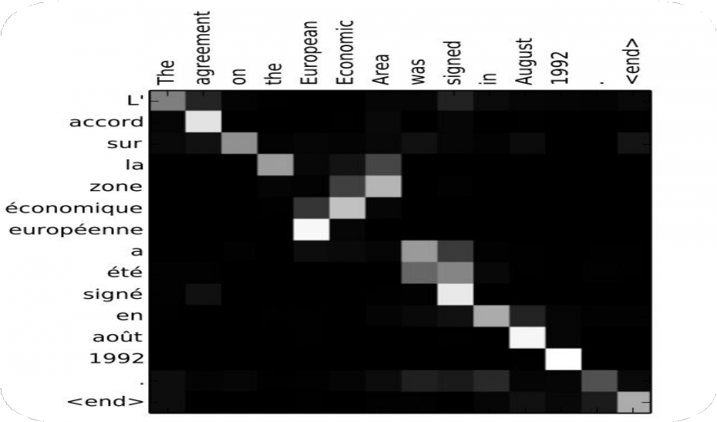
Impact of Attention Mechanism
Europèenne —> European
Agreement —> Accord
Area —> Zone

Slide 9
Translate the following to German:
English - "how are you" German- "wei geht es dir"

Slide 10
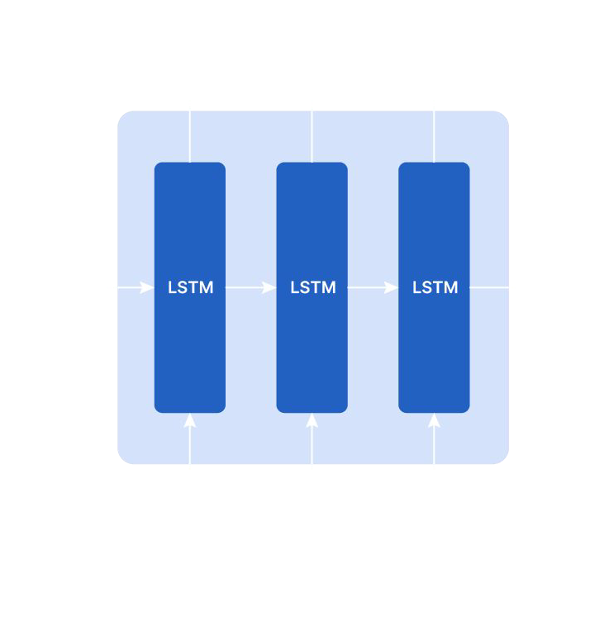
Attention Context Vector
Attention context vector is the weighted sum of the hidden states of the encoder.
h1
h2
h3
Ci
Attention context vector (Ci)
C_{i}
= ∑ α_{ij}h_{i}

Slide 11
Attention weights
α_{ij} weights for ith time step in decoder and jth in
the encoder
wie
 | How | Are | you
Wie | ^{α}11 | ^{α}12 | ^{α}13
geht | ^{α}21 | ^{α}22 | ^{α}23
er | ^{α}31 | ^{α}32 | ^{α}33
dis | ^{α}41 | ^{α}42 | ^{α}43
are
<START> wie

Slide 12
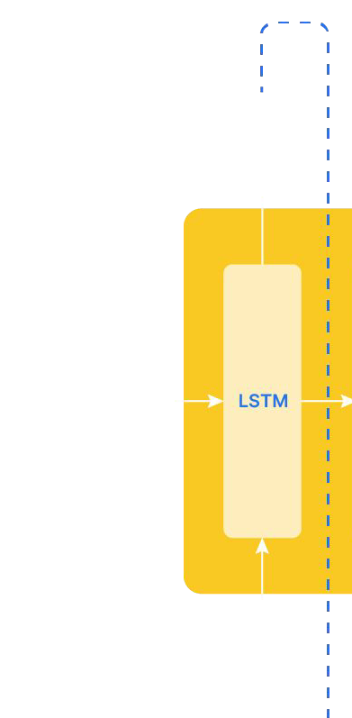
Attention Context Vector
i = 1
C₁
^{α}12 ^{α}13
C1 = α₁₁ . h1 + α₁₂ . h2 + α₁₃ .
h3
^{α}11
S₀
S₁
h₀
h₁
h₂
h₃
C₁
<START>
j = 1
j = 2
j = 3

Slide 13
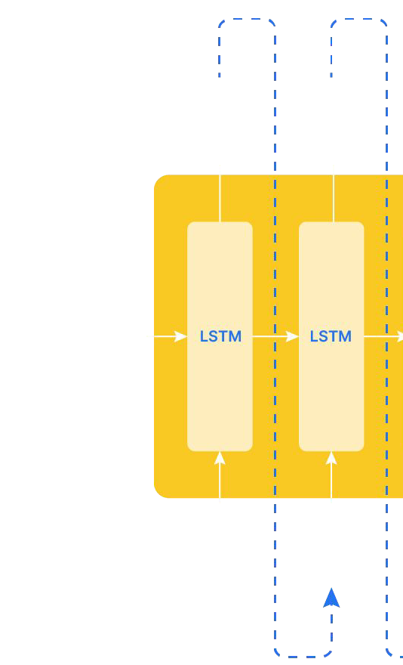
Attention Context Vector
i = 2
C₂
^{α}22 ^{α}23
C₂ = α₂₁ . h₁ + α₂₂ . h₂ + α₂₃ . h₃
^{α}21
S₀
S₁
S₂
h₀
h₁
h₂
h₃
C₁
C₂
<START>
j = 1
j = 2
j = 3

Slide 14
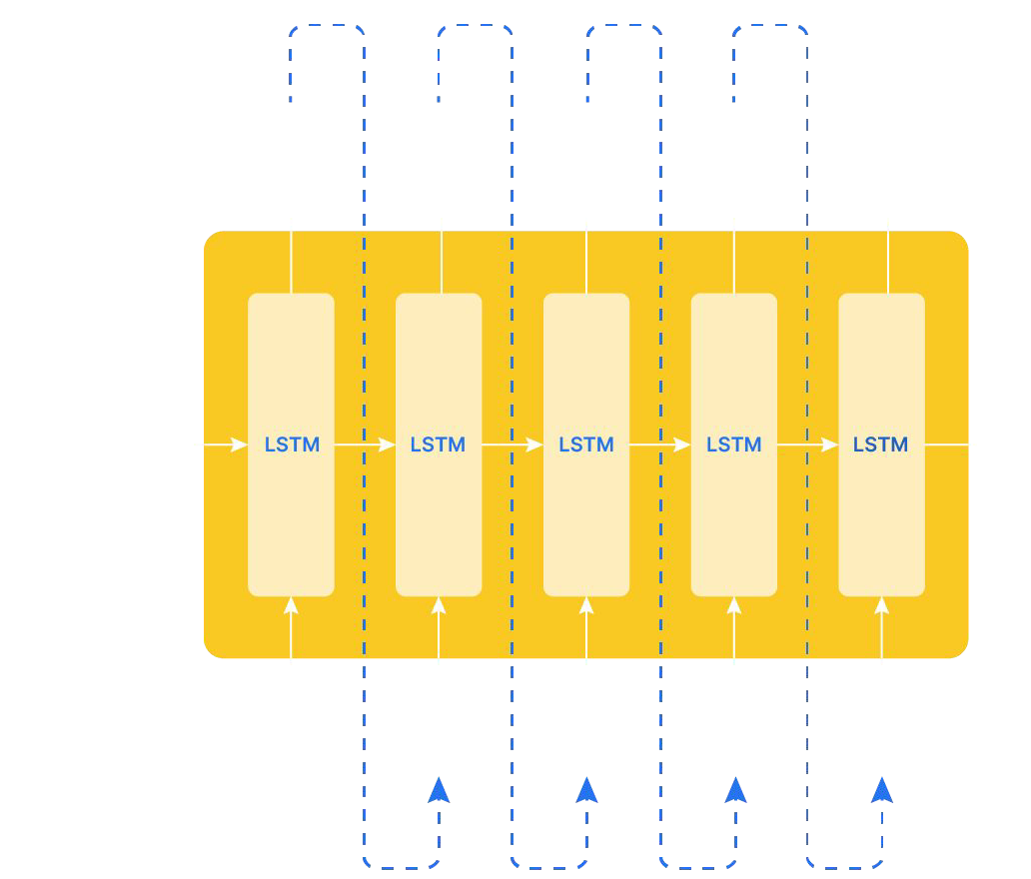
Attention Context Vector
i = 3 i = 4 i = 5
C₃ = α₃₁ . h₁ + α₃₂ . h₂ + α₃₃ . h₃
C₄ = α₄₁ . h₁ + α₄₂ . h₂ + α₄₃ . h₃
S₁
S₂
S₃
S₄
C₅ = α₅₁ . h₁ + α₅₂ . h₂ + α₅₃ . h₃
C₂
C₃
C₄
C₅
C_{i}
= ∑ α_{ij}h_{i}

Slide 15
Attention Weights
 | How | Are | you
Wie | ^{α}11 | ^{α}12 | ^{α}13
geht | ^{α}21 | ^{α}22 | ^{α}23
er | ^{α}31 | ^{α}32 | ^{α}33
dis | ^{α}41 | ^{α}42 | ^{α}43

Slide 16
i = 2
S₀
S₁
C₁
C₂
<START>

Slide 17
i = 2
C₂
^{α}22 ^{α}23
C₂ = α₂₁ . h₁ + α₂₂ . h₂ + α₂₃ . h₃
^{α}21
S₀
S₁
h₀
h₁
h₂
h₃
C₁
C₂
<START>
j = 1
j = 2
j = 3

Slide 18
i = 2
C₂
C₂ = α₂₁ . h₁ + α₂₂ . h₂ + α₂₃ . h₃
^{α}21
α α
22
23
Exp e ²³
S₀
S₁
=α₂₃
∑ Exp e ^{ij}
h₀
h₁
h₂
h₃
h₃
C₁
C₂
Softmax
^{α}23
^{e}23
<START>
j = 1
j = 2
j = 3
S₁

